Slide 1
BPM Calibration Update
Ed Brash
July 12, 2018

Slide 2
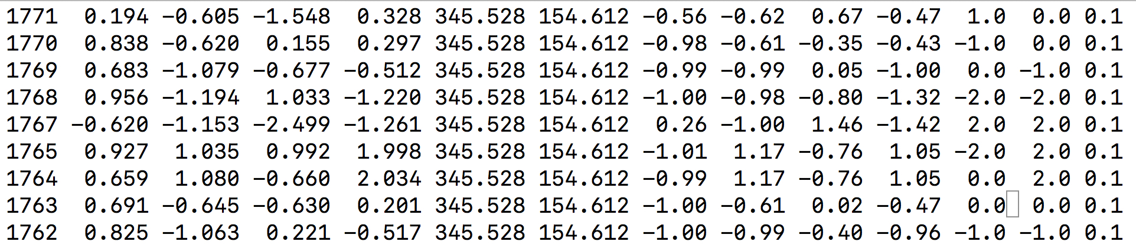
HARP Scans
For each run, BPM average positions (Ax,Ay,Ax,Bx,By,Bx,Cx,Cy,Cy) are from striptool – not used in this analysis
HARP A and B X/Y average positions are from Accelerator’s HARP Fitter tool
BPM Cx,Cy nominal positions are listed next – again, not used in this analysis – cross check only
Error in HARP A and B X/Y average positions set at 0.1 mm (suggested by Dave Gaskell)
Run 1766 rejected from analysis – inconsistency between EPICS data and supposed corresponding HARP scan!!!

Slide 3
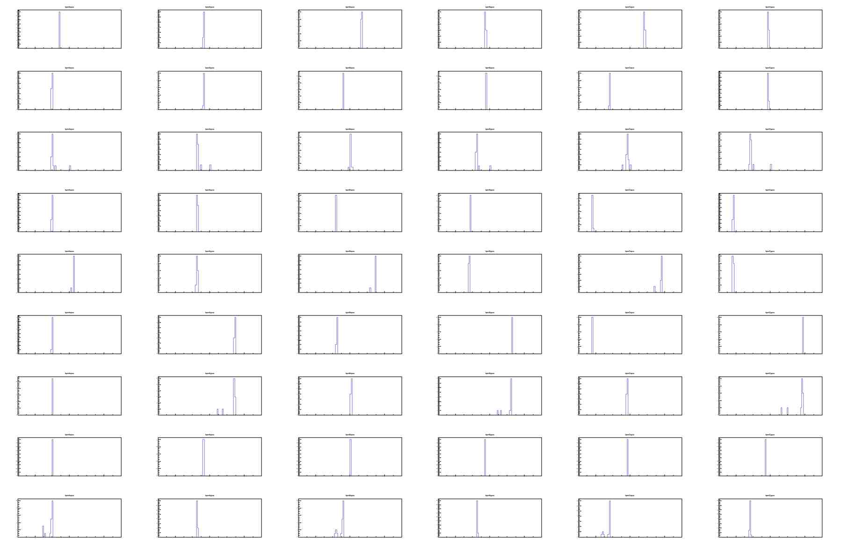
RAW BPM positions from EPICS data

Slide 4

RAW BPM positions after cuts to clean up

Slide 5
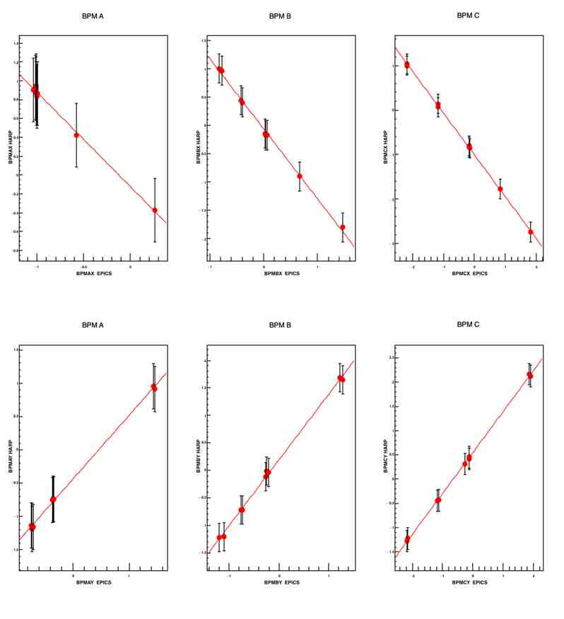
HARP vs. BPM Calibrations

Slide 6
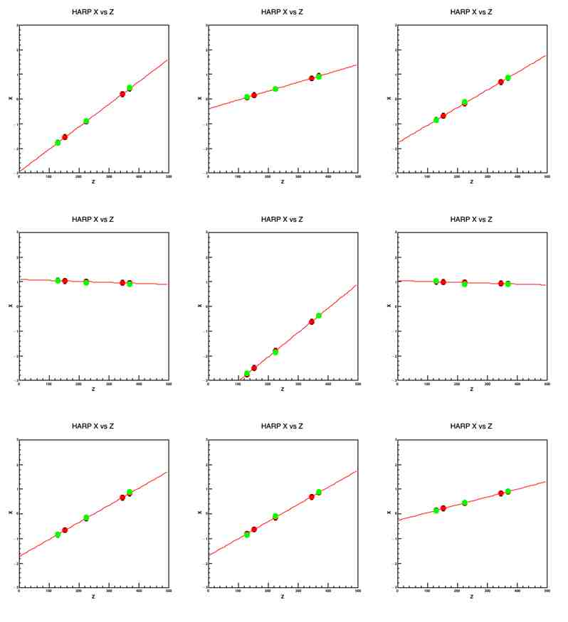
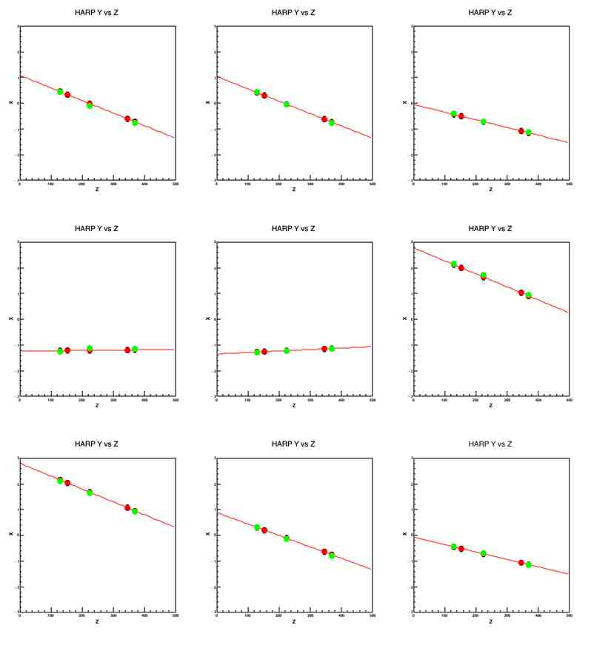
Sanity Checks for Internal Consistency

Slide 7
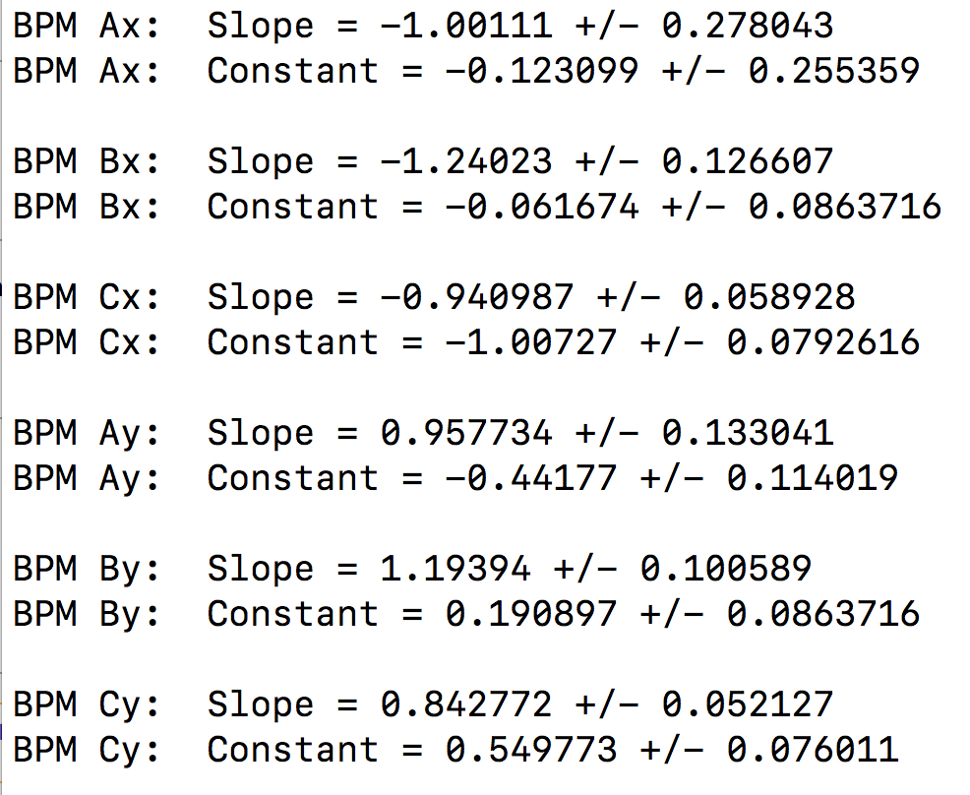
Gains and Offsets
Projected HARP X/Y Position (Truth) = slope * Raw EPICS BPM X/Y Position + offset

